Slide 1
MUSIC
RECOMMENDATION
SYSTEM
MUSIC
RECOMMENDATION
SYSTEM

Slide 2

Our Team:
Zoha Emaan bsdsf21a022
Barira Sajjad bsdsf21a040

Slide 3
Introduction
Our project focuses on developing a classification-based music recommender system using Spotify's Million Song Dataset. We will use lyrics from songs, along with advanced classification techniques, to create a platform that offers personalized music recommendations to users. By analyzing song lyrics, we aim to understand the underlying themes and emotions of each song, allowing us to recommend music that resonates with each user's unique musical preferences. This approach will enhance the music discovery experience, helping users discover new music they love.

Slide 4
Business Case
This project is centered around developing a sophisticated music recommender system that leverages Spotify song lyrics to provide highly personalized recommendations. Through the application of advanced Natural Language Processing (NLP) and classification techniques, the system preprocesses the lyrics, extracting key themes. This enables the categorization of songs based on their lyrical content, allowing for a deeper understanding of the music's lyrics.
By incorporating these insights, the system delivers personalized music recommendations that resonate with users' unique tastes.

Slide 5

SPOTIFY!
Spotify Million Song Dataset

Slide 6
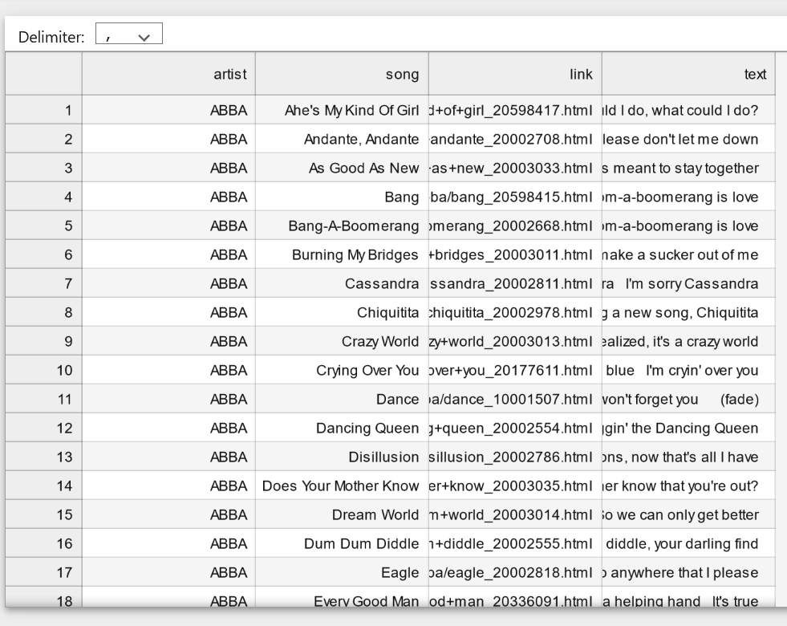
Spotify Million Song Dataset

Slide 7
THANKS!
Any questions?

